Slide 1

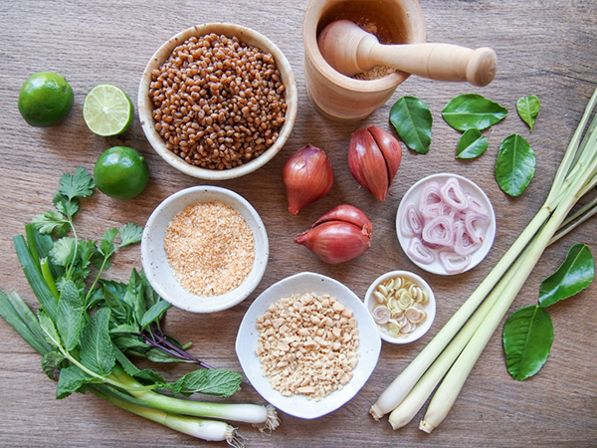
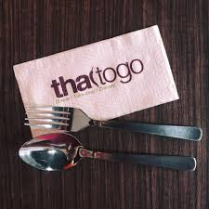
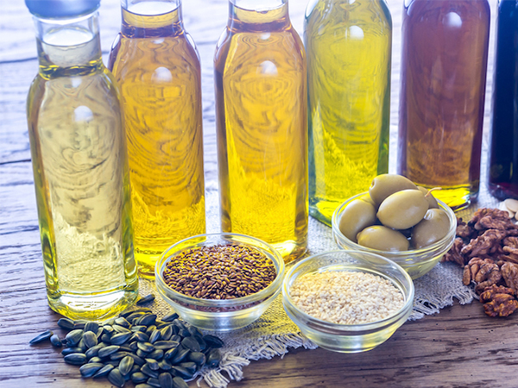

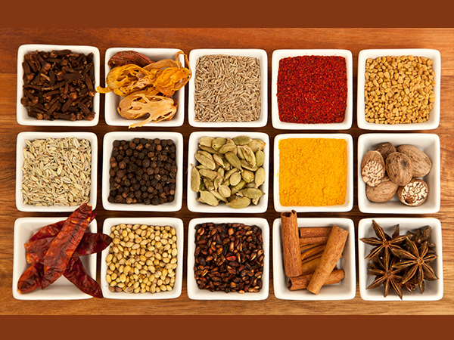
Presentation
@ASKTraining_SCTP-DMC_Capstone Project by Lim S K Elsie – @ 24 Aug 2024

Slide 2
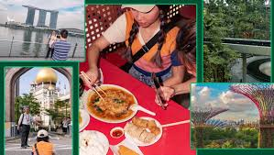
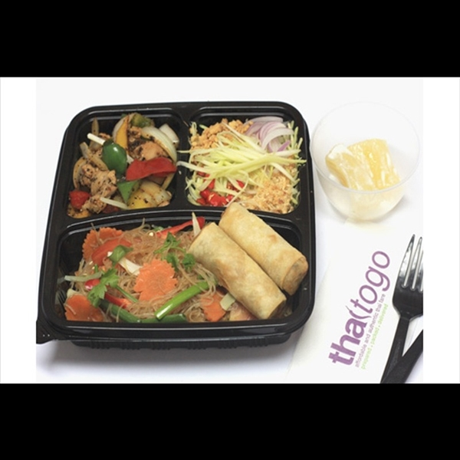

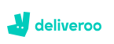
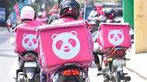
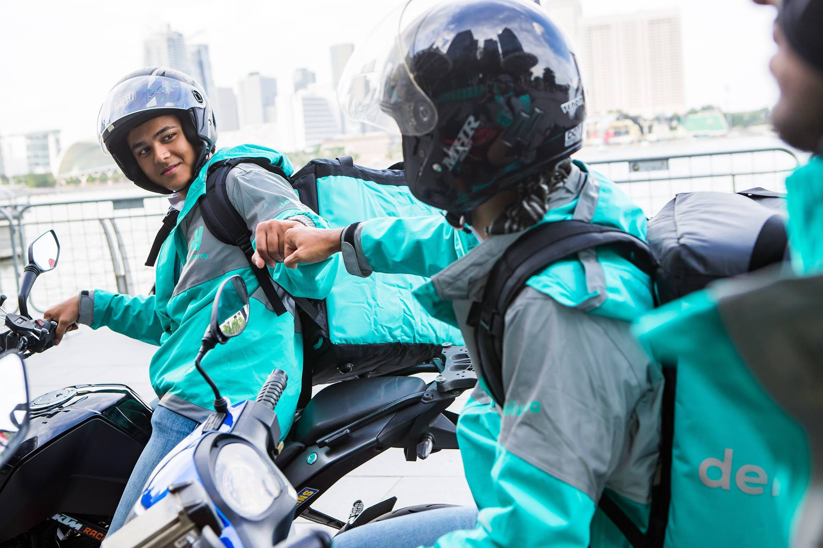
Company Background
TTG – a Halal-certified Thai restaurant located at Changi Road – walking across from Eunos MRT
In operation for 10 years.
Offerings:
Dine In
Order & Self Pickup
Island-wide delivery
Mini-Catering for a minimum of ten (10) persons

Slide 3
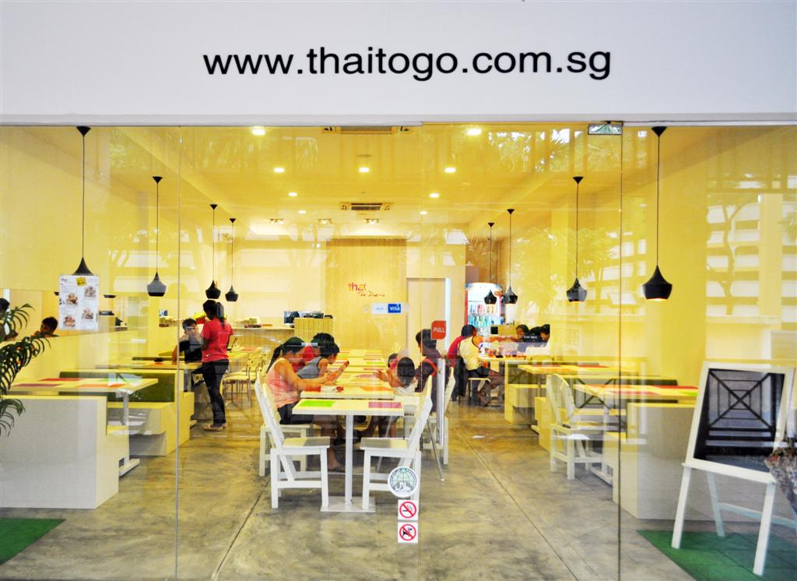
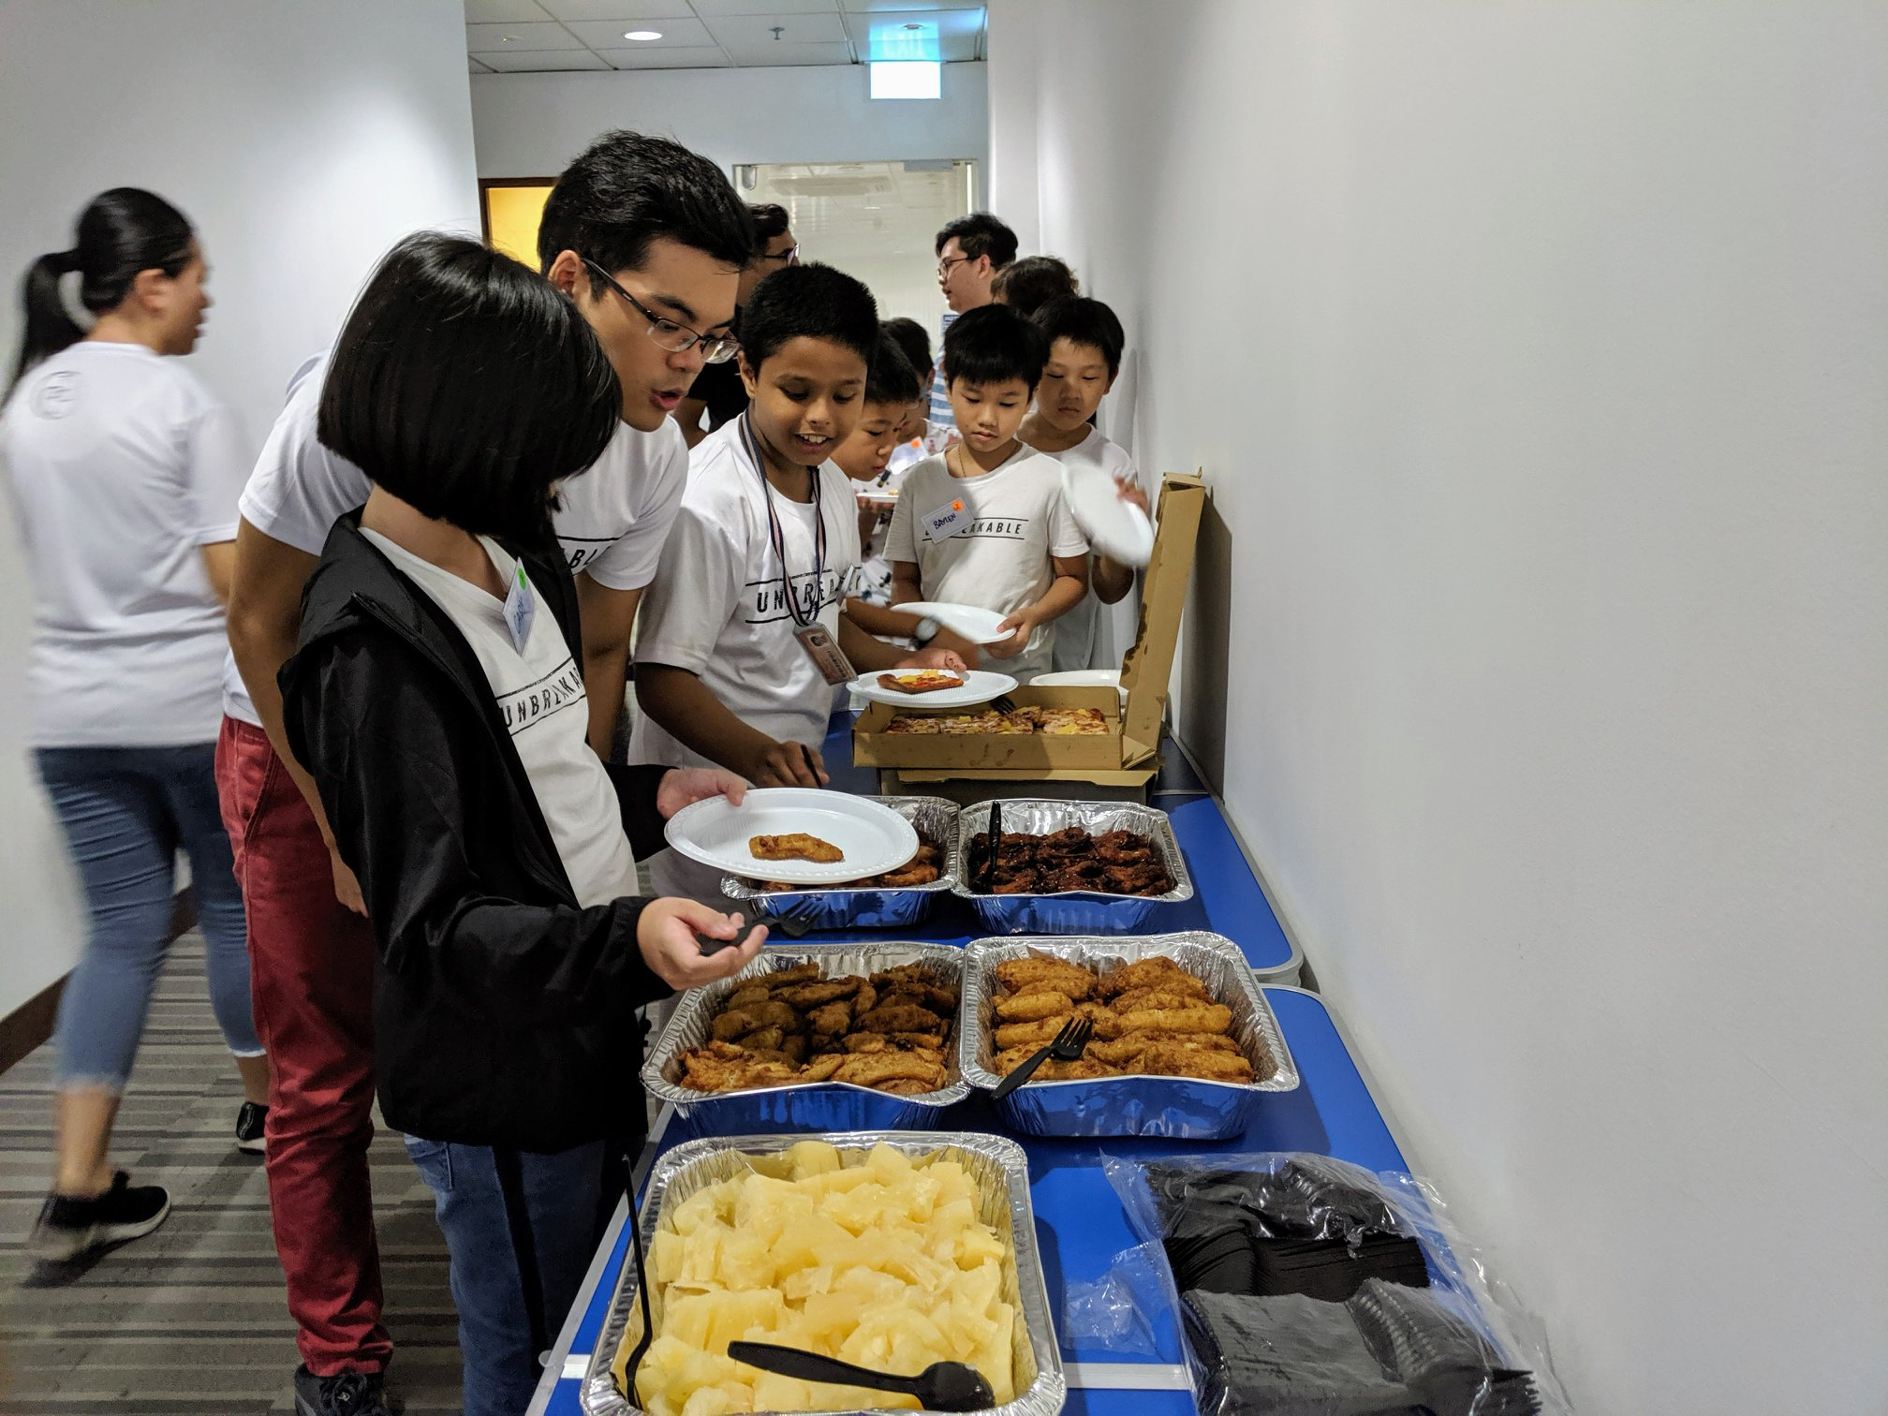
Core Services
& Biz Persona
#1 Online Orders and Delivery
Nearby and Island Wide
#2. In-Restaurant Dining
Nearby residents and office workers
#3 In-Restaurant - 40 seaters Catering
Special for customers looking to host events or small parties for at least 20 persons.

Slide 4
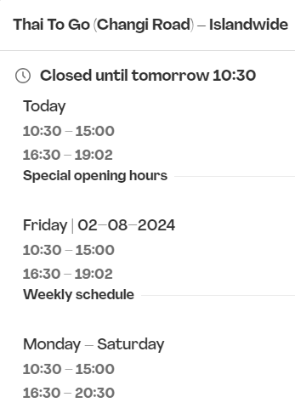


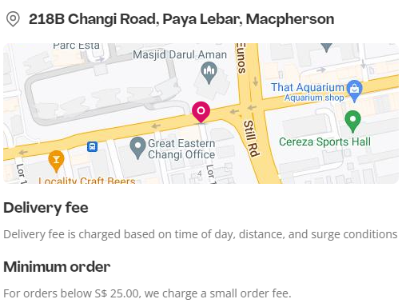
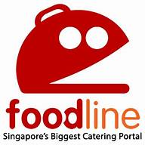
Current
Lead Generation
All leads are currently generated by
"WORD of Mouth”
for delivery leads https://www.foodpanda.sg/restaurant/jedo/thai-to-go-changi-road-islandwide
Catering leads https://www.foodline.sg/catering/Thaitogo/

Slide 5
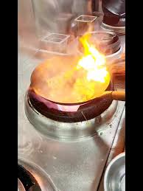
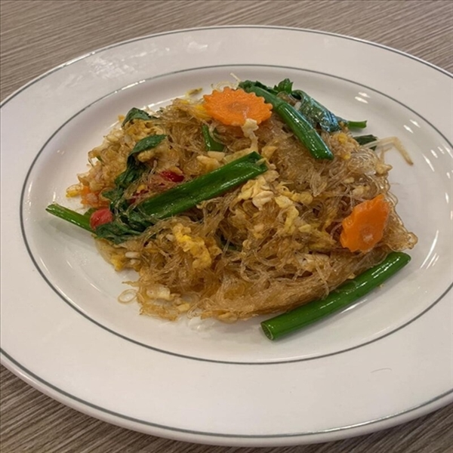
Unique
Value Proposition
Homely yet affordable cuisine
Mixed Fusion Thai, Malay Fusion and Western Menu
Pricing more affordable than other restaurant chains like
Sanook & Thai Express
Recipes & Food taste cater to locals
Mini catering can be booked one day ahead, instead of 3-4 days in advance
Flexible menu depending on what the customers want
(bento box, lunch-set)
Host parties (40 seaters) - minimum order of 20 persons

Slide 6

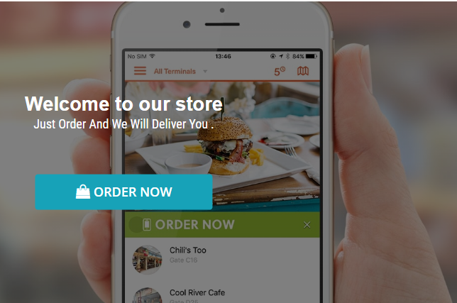
Problem Statement
(Business Challenge)
"Open to suggestions for special offers to get more online orders“
“Business was good before Covid but has since reduced!
So Now "I want to increase online orders "

Slide 7
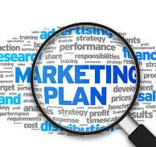
Marketing Plan

Slide 8

Executive Summary
1. Business Objective
Increase Online Orders by 50% in
six (6) months
2. Target Market
Millennial and Gen Z Malay Couples* with young children.
- Income - household of upper
lower to middle income.
- Enjoy authentic Thai cuisine
with Malay style fusion menu.

Slide 9
Executive Summary
3. Market Need
Persona (Customer) looks for tasty traditional, fusion, flavorful quality Thai food that caters to individuals and family gatherings with personalized menu prep and convenience.
4. Product Overview
Thaitogo offers a variety of authentic Thai dishes, using fresh ingredients and traditional recipes.
Key selling points
1. Experience in online delivery
2. Customizable online orders
3. Mini catering packages

Slide 10
Executive Summary
5. Market Strategy
Channels to drive an increase in online orders targeting young Malay couples with/without children.
Social Media Marketing
- Facebook/Instagram and TikTok
Google S E Optimization
Content
*Family-Oriented Posts* content
that resonates with the Persona.
Quick short videos of meal preparations by Chefs
Customer testimonials & pictures from Malay families, bonding moments over food.
Design family meals, and special promotions for family-sized portions, convenience and the joy
of eating a meal together.

Slide 11
Persona
(Ideal Customer)

Slide 12



Rajwa Alimah
1. Demographic Information
Name: Rajwa Alimah
Age: 35
Occupation: Child Care Principal
Education Level: Degree in Early Childhood
Location: Pat’s Schoolhouse *Katong*
Married: with two kids aged 5 and 2
Total Household Income: $110,000 p.a.
Notes
Alimah – is a busy working mother, who values convenience and quality.
She often seeks quick, reliable meal solutions for her family and periodically needs catering for small gatherings and work events.
She enjoys authentic Thai fusion cuisine, appreciates services that offer easy online ordering and delivery.

Slide 13
2. Psychographic Information
Life stage: Young Parents with two young children
Pain Points
Lack of convenient, high-quality meal options that cater to both adults and children.
Limited time to prepare meals due to a busy work schedule.
Needs reliable catering services for small family gatherings and school events but often finds them too expensive or inflexible.
Motivations
Desire for convenient meal solutions that do not compromise on taste and quality.
Loves to provide her family with diverse, nutritious meals without the hassle of cooking.
Challenges
Uncertain about the quality and reliability of new food delivery and catering services.
Concern about the cost and value of services provided.
Limited time to research and compare different options for meal delivery and catering.
Core Values & Beliefs
Value the Convenience of home-style meals that save time, reducing stress to allow her to focus on her family and work.
Prioritize Family needs and preferences of both adults and children for food.
Support for local F&B businesses that contribute to the community and local economies.

Slide 14
3. Service Needs & Preferences
Online Behavior
Active on social media and Google searches for meals using a mobile phone
Reads reviews and testimonials on platforms like Google Reviews and Facebook.
Follows food blogs and influencer recommendations.
Uses mobile apps for ordering food and checking for new restaurants.
Preferred Communication Channels
Email for receiving promotions, updates, and order confirmations.
WhatsApp Text messages and Food app notifications on real-time order status and delivery update
Facebook and Instagram for engaging with brands, participate in contests, and receive updates on new menu items or special offers.
Service Expectations
High-quality, flavorful food that meets her family dietary needs and preferences
Quick and reliable delivery with accurate order fulfillment.
Customizable order options with flexibility in menu selection and portion sizes.
Excellent customer service with prompt responses to inquiries and issues.
Easy and intuitive online ordering system.
Price Sensitivity
Considers extremely low prices as an indicator of low or poor quality.
Prefers mid-range pricing that balances quality and affordability.
Will pay a premium for high-quality ingredients, exceptional service, and reliable delivery.
Values transparent pricing with no hidden fees or charges.

Slide 15

4. Decision-Making Process
Information Sources
Relies on online resources such as restaurant and Google reviews and
Social Media such as Facebook, IG, and Tiktok posts).
Seeks recommendations from peer groups and community forums.
Looks at ratings and reviews on Food delivery apps such as Food Panda
Influencers
Family and friends for trusted recommendation.
Social media influencers with a strong following and credibility in the online space.
. Positive reviews and testimonials from satisfied customers.
Barriers to Entry
Concerns about whether the cost and the quality of food provide good value
for money.
Lack of awareness about Thaitogo Restaurant and its offerings.
Decision Triggers
The need for a quick and reliable meal solution due to a busy schedule.
Special occasions or gatherings that require catering services.
Promotions, discounts, or special offers that make the service more attractive.
Positive word-of-mouth and whether the restaurant gets to be featured in local and social media or food blogs.

Slide 16
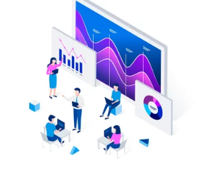
SWOT Analysis

Slide 17
SWOT Analysis
Strengths
Unique Selling Proposition (USPs)
Authentic Thai cuisine with a focus on
fresh ingredients and traditional recipes,
combined with convenient and reliable
online delivery and catering services.
Areas of Superiority
Speed and reliability of delivery service.
Customizable mini catering packages for small events.
Customer satisfaction due to consistent food quality and service.
Strong online presence with an intuitive ordering system.
Weaknesses
Competitors' USPs
Sanook Kitchen offers a more extensive menu with fusion dishes appealing to a broader audience.
Thai Express is well known for its long history (22 years), fast service, and affordable pricing.
Marketing Resources
Limited budget for extensive marketing
campaigns compared to stronger competitors.
Skills to Improve
Need to enhance digital marketing skills,
especially in SEO, social media advertising,
and data analytics.

Slide 18
SWOT Analysis
Opportunities
Improving Business
By focusing on marketing efforts to highlight the unique flavors and authenticity of the various cuisines.
Introduce first timer discounts to encourage repeat business and
word-of-mouth promotion.
Selling Points
Emphasize the convenience and reliability of delivery and catering services in marketing campaigns.
Highlight customer testimonials and positive reviews in food delivery apps.
Threats
Alternate Solutions
Persona (Customer) may consider meal prep services, other ethnic cuisine restaurants, or grocery delivery services that offer ready-to-eat meals.
External Factors
Change in economic situation that can affect spending habits on dining out.
Singapore food laws and food safety, delivery logistics, and manpower issues may impact operational costs.
Increased competition from new F&B players in the food delivery and catering market around Changi Road.

Slide 19
Competitors -
SWOT Analysis
Strengths
Extensive menu feature - a good mix of
traditional and fusion Thai dishes.
Broad Appeal to a diverse customer base.
Strong brand recognition and established customer loyalty.
Weaknesses
May not offer personalized or customizable catering options just like Thaitogo does
May slower delivery times due to a broader menu and high demand.
Thai Express (B)
Strengths
Fast service and affordable pricing, attracting budget-conscious customers.
Streamlined operations for quick meal preparation and delivery.
High brand recognition with a widespread presence (franchise).
Weaknesses
May focus more on speed than on the authenticity and quality of dishes.
Less emphasis on catering services, especially for small events.
Sanook Kitchen (A)

Slide 20

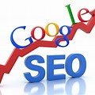
Competitive Analysis
(WEBSITE)

Slide 21

For Website-Online Presence, the critical components are:
1. Design and Usability
User Interface (UI) Design
First impressions count as a well-designed
website will enhance user experience, is engaging
and easily accessible.
A clear, aesthetically pleasing interface can attract
users and keep them interactive and happy.
User Experience (UX)
Ensure the website is user-friendly and intuitive, will help to reduce bounce rates and increase
conversion rates.
A seamless UX facilitates easier navigation, encouraging users to stay longer and take actions such as “Order Now”!
Mobile Responsiveness
With 90% mobile usage, ensure the website is mobile-friendly to reach a wider audience.
Mobile responsiveness affects user engagement and search engine rankings.
2. Content
Quality and Relevance
Creating content that is high quality, informative, engaging, and shareable can help attract more organic traffic and improve your website's ranking on search engines.
Well-crafted content helps attract and retain visitors, enhancing the Thaitogo brand as an expert in Thai cuisine.
Content Strategy
A well-defined content strategy can attract and retain a specific target audience, leading to higher engagement.
Strategic content planning ensures that the messaging aligns with business goals and audience needs.
21

Slide 22
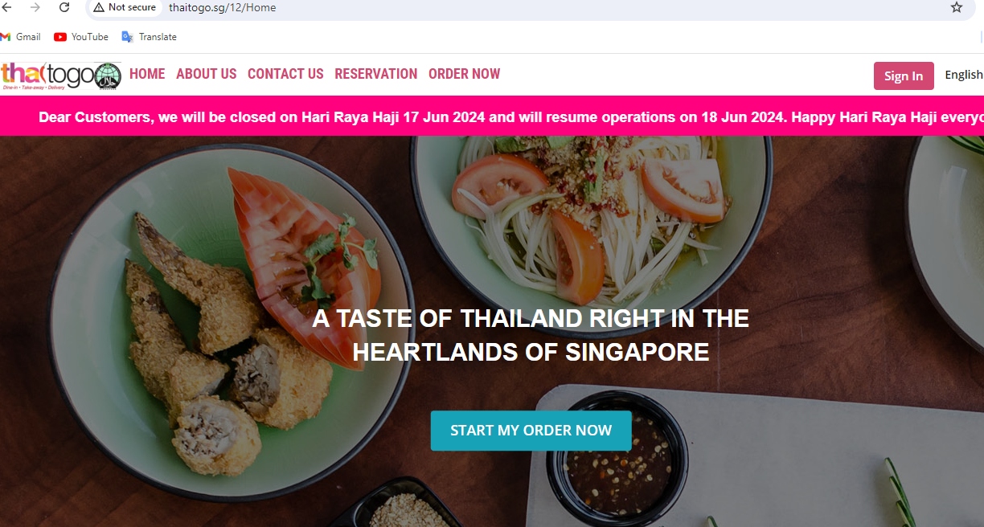
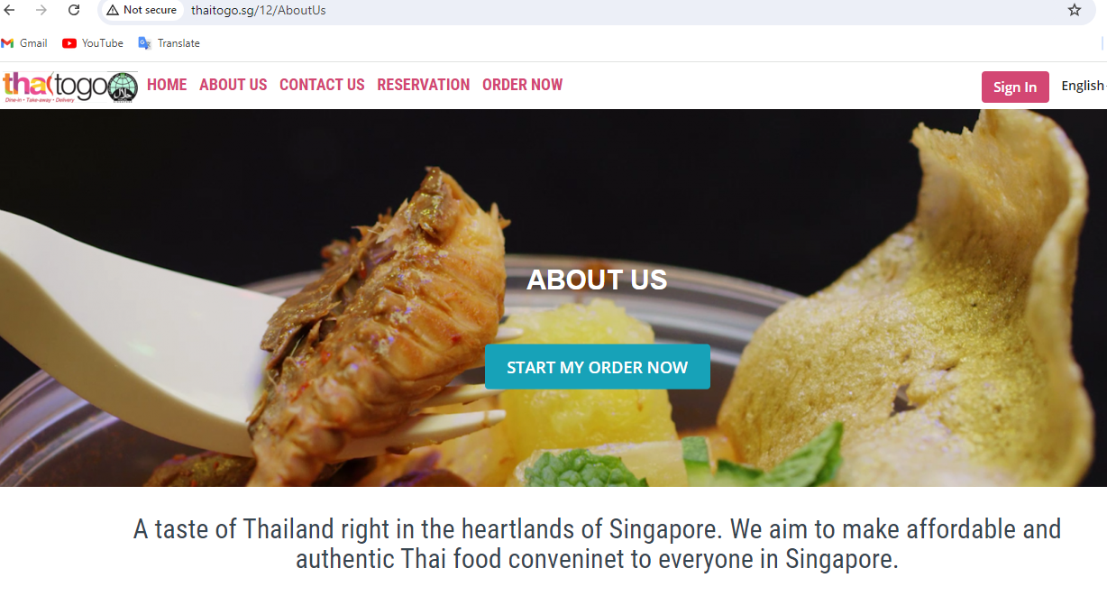
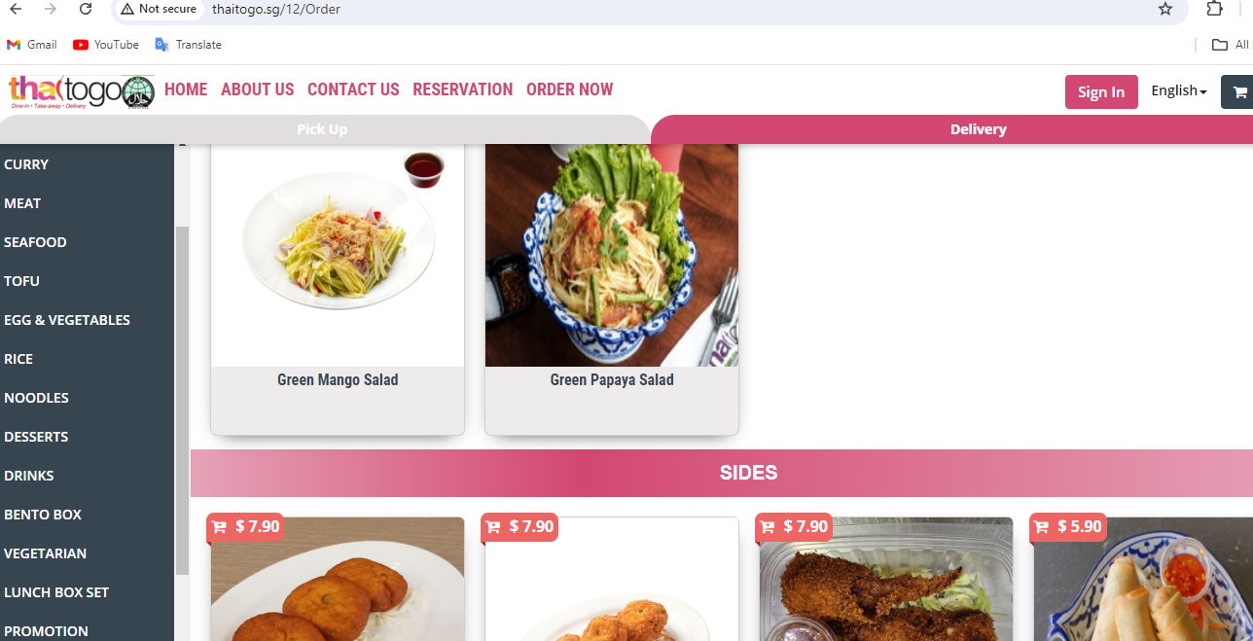
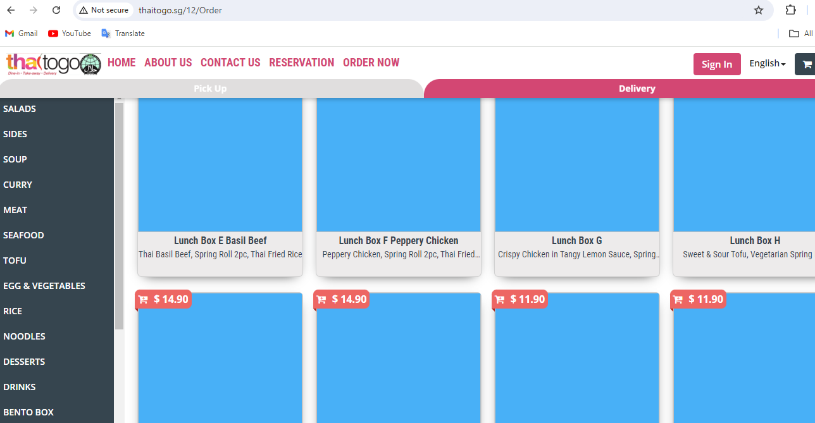
http://thaitogo.sg/12/Order
Need to secure to HTTPS
NOT SECURE
These are gaps that need to be removed or fill up details ??

Slide 23
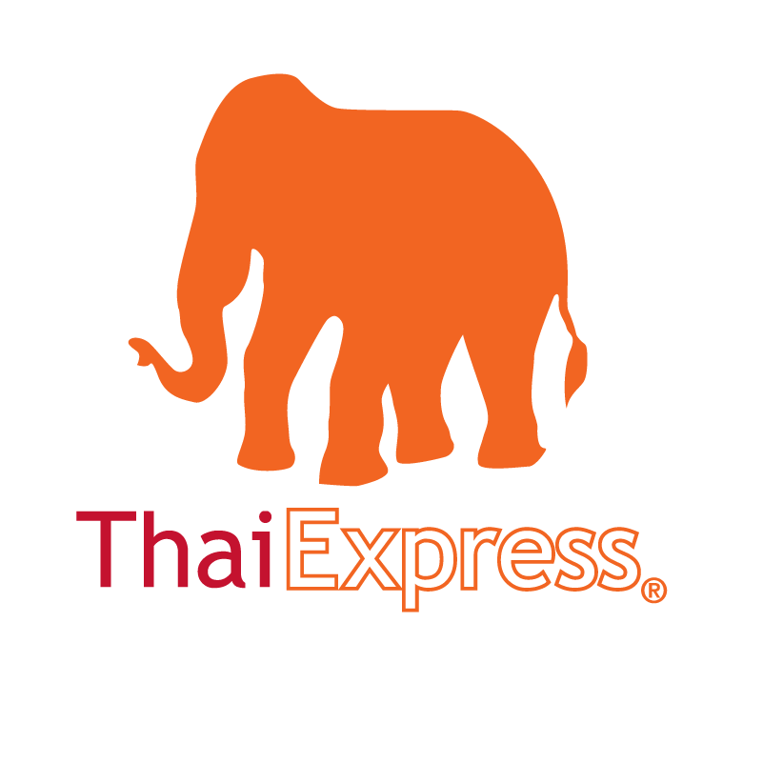
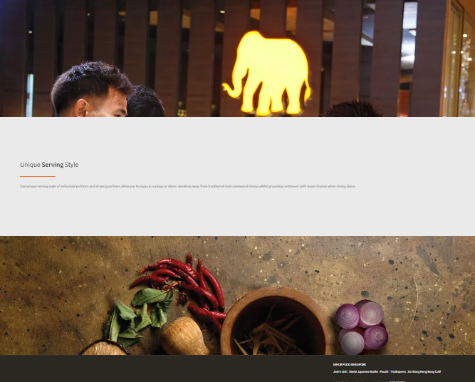
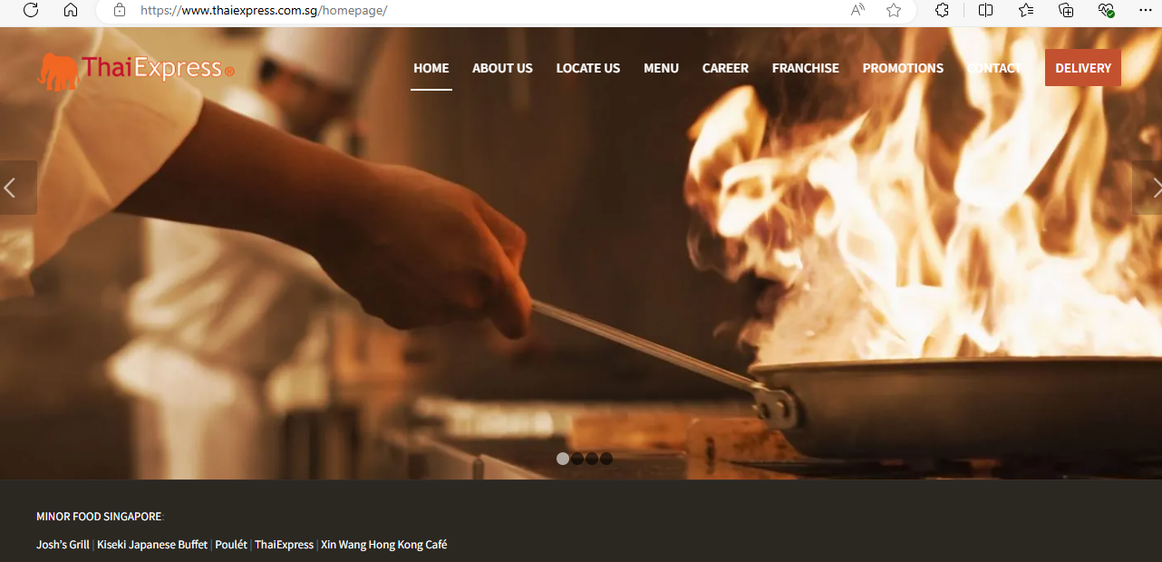
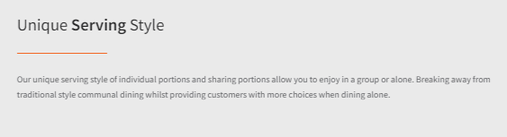
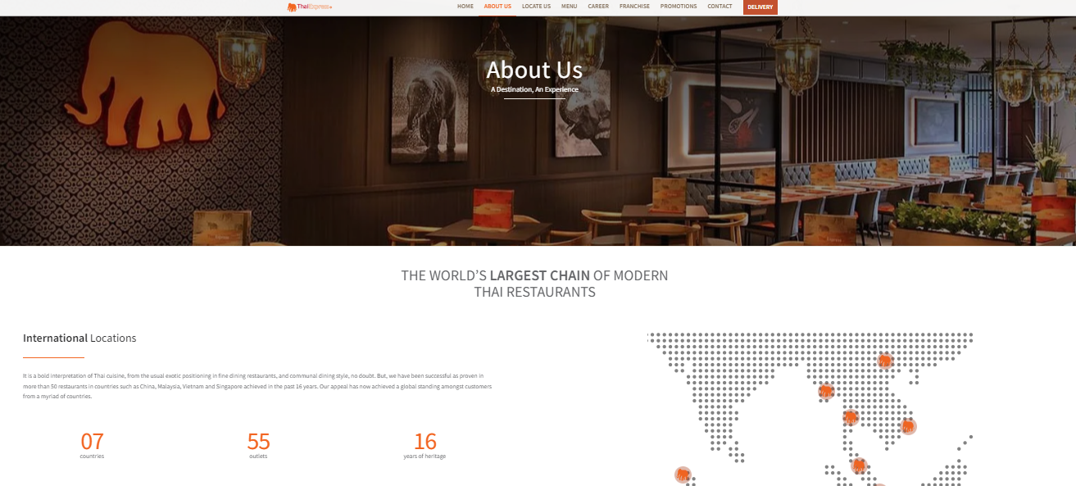
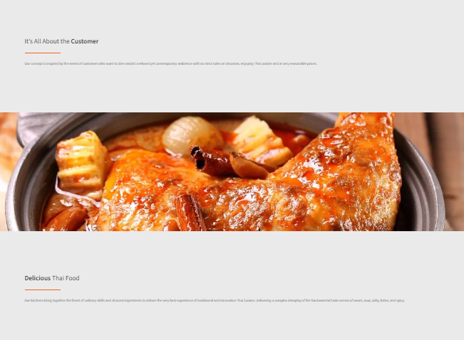
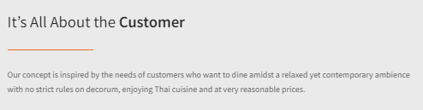
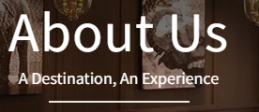
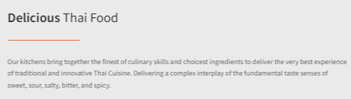
https://www.thaiexpress.com.sg/about-us/
Branding
& Positioning

Slide 24

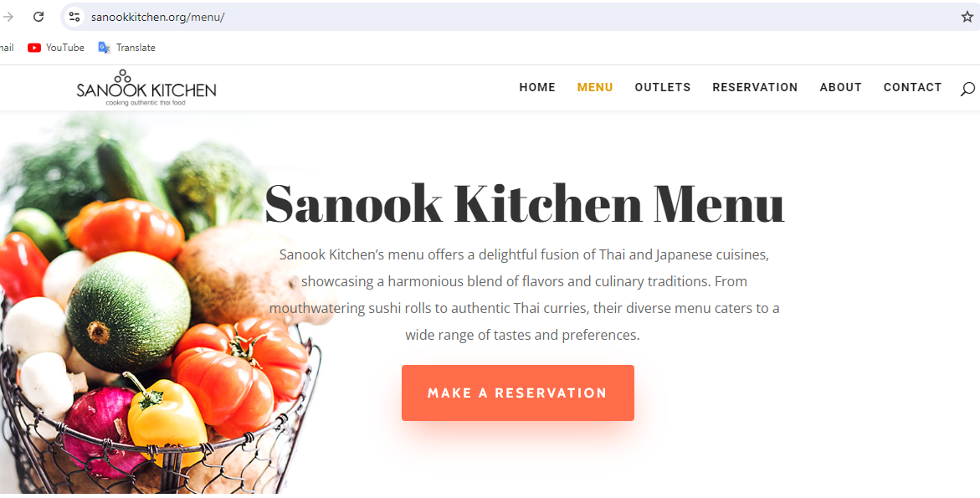
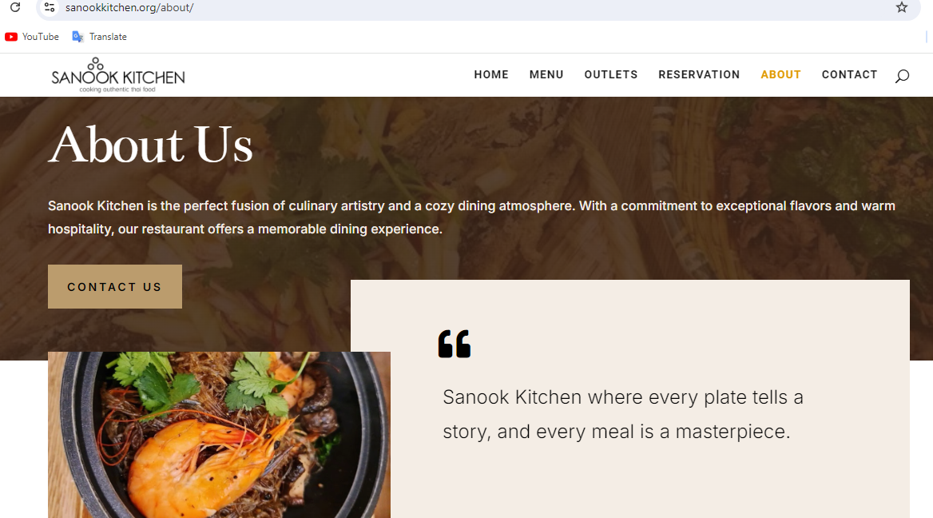
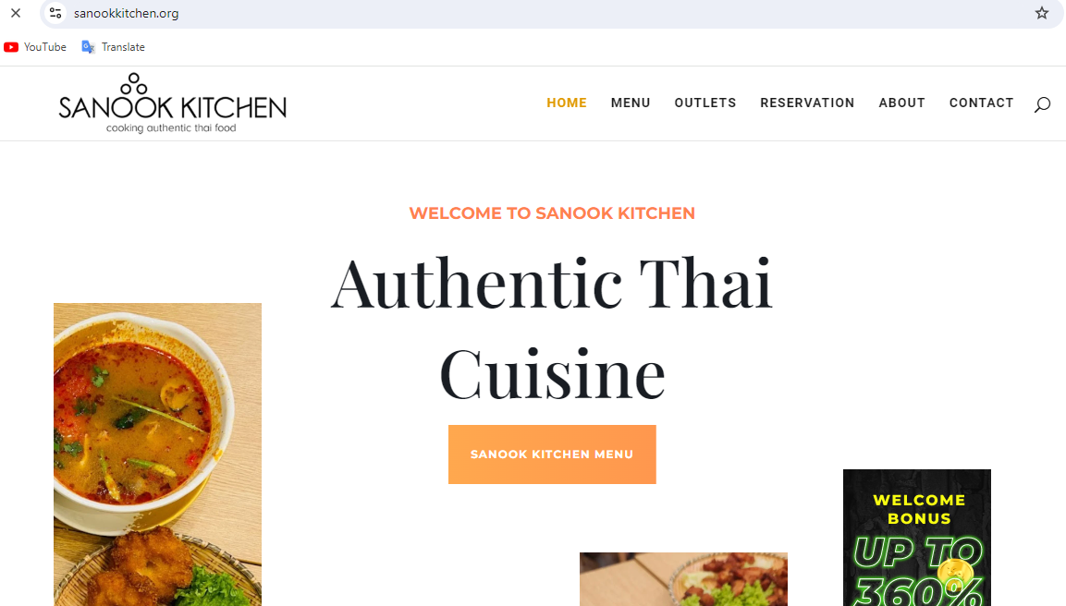
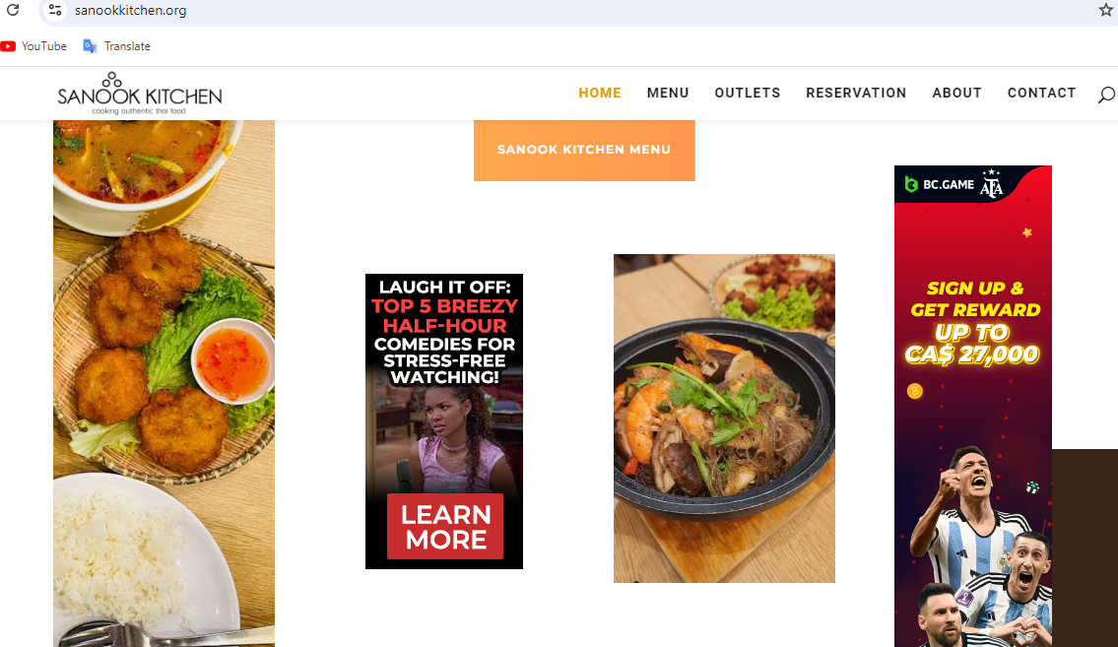
https://sanookkitchen.org/about/
Branding &
Positioning

Slide 25
Competitors
(Website Analysis)

Slide 26
Competitors’ Website Technical Analysis, check these areas
1. SEO and Visibility
Keywords and Optimization
Effective use of keywords can improve a
website's visibility on search engines,
driving more organic traffic.
2. Backlink Profile
A strong backlink profile can enhance
domain authority and improve search
engine rankings.
2. Technical Performance
Site Speed
Faster websites provide a better user
experience, affecting rankings and
conversion rates.
2. Security (HTTPS)
Ensures data protection, builds trust with users, and is a ranking factor for search engines.
26

Slide 27

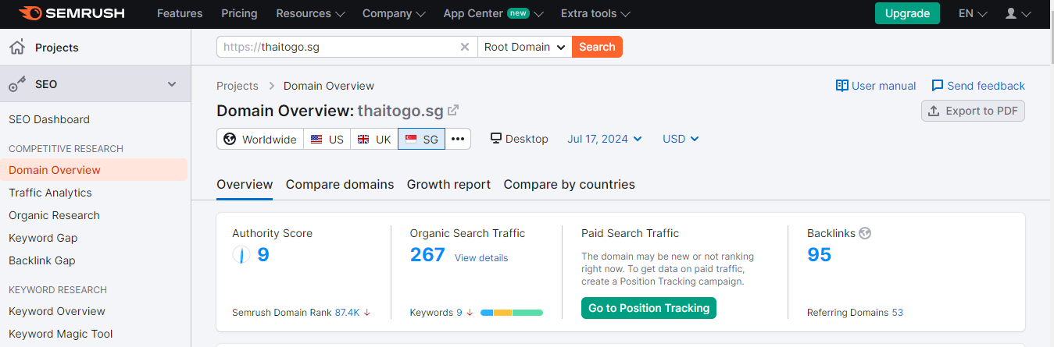
http://thaitogo.sg/12/Order
https://www.semrush.com/
0
0
27

Slide 28
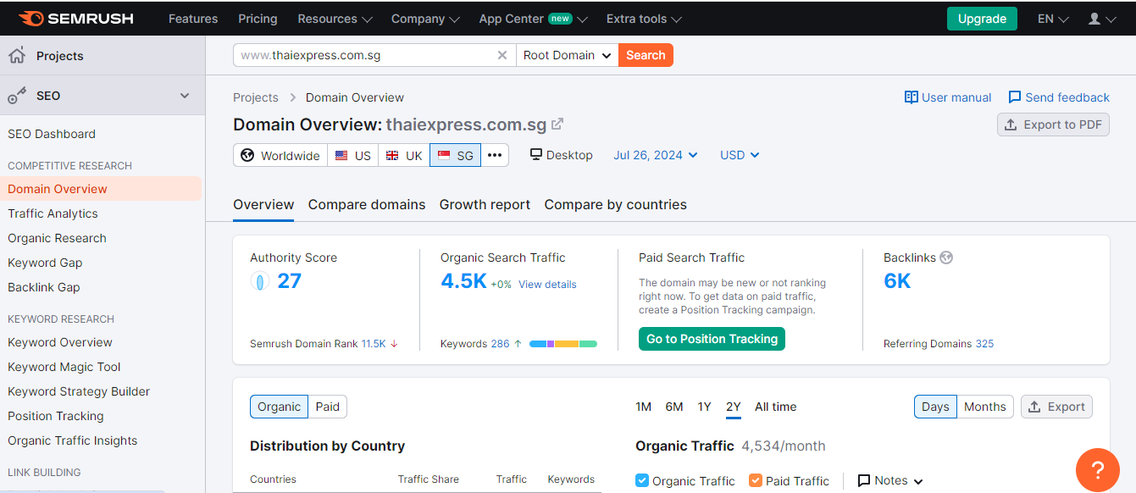
https://www.thaiexpress.com.sg/
https://www.semrush.com/

Slide 29
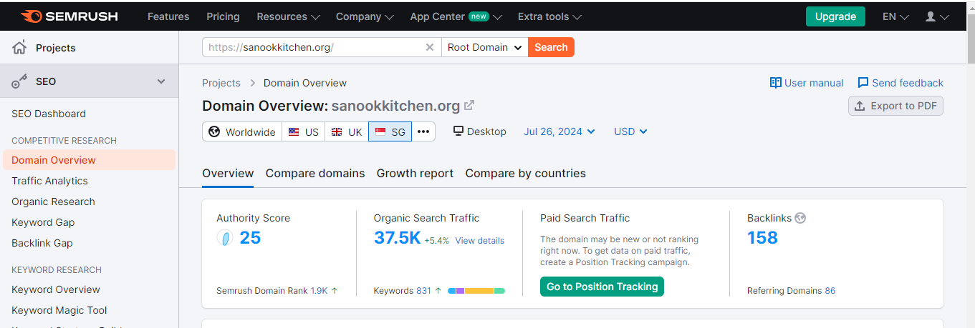
https://sanookkitchen.org/about/
https://www.semrush.com/
0
%

Slide 30
For Website Analysis, the critical technical areas are:
1. SEO and Visibility
Keywords and Optimization
Effective use of keywords can improve a
website's visibility on search engines,
driving more organic traffic.
2. Backlink Profile
A strong backlink profile can enhance
domain authority and improve search
engine rankings.
2. Technical Performance
Site Speed
Faster websites provide a better user
experience, affecting rankings and
conversion rates.
2. Security (HTTPS)
Ensures data protection, builds trust with users, and is a ranking factor for search engines.
30

Slide 31
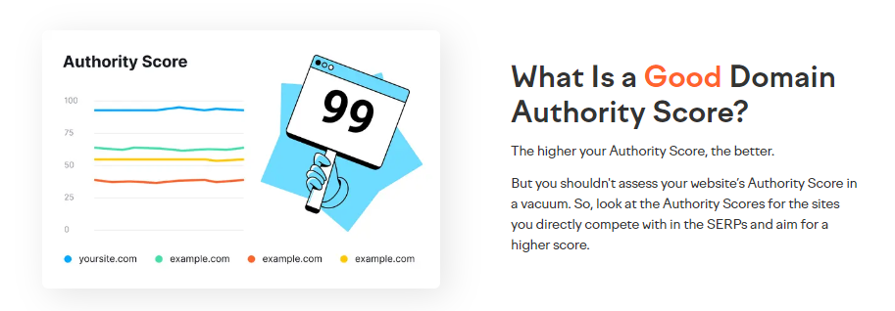
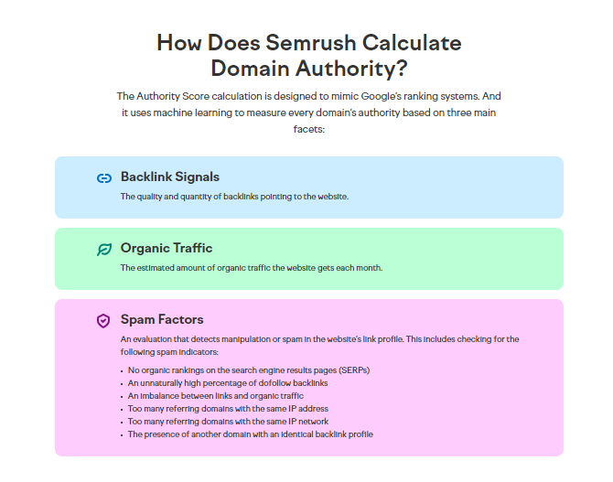
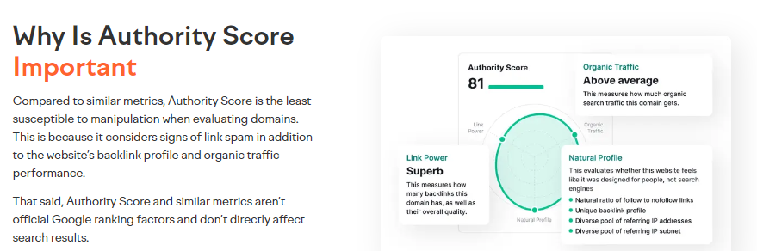
http://thaitogo.sg/12/Order
https://www.semrush.com/
31

Slide 32
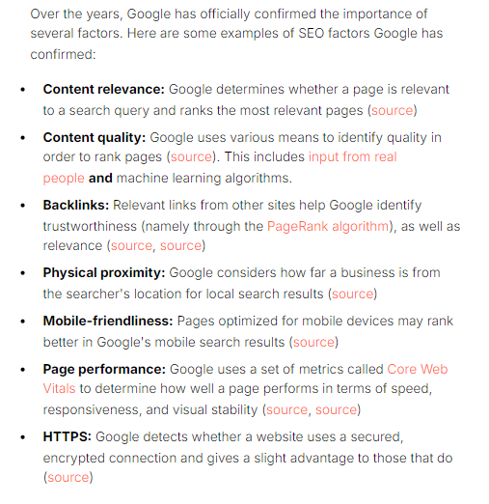
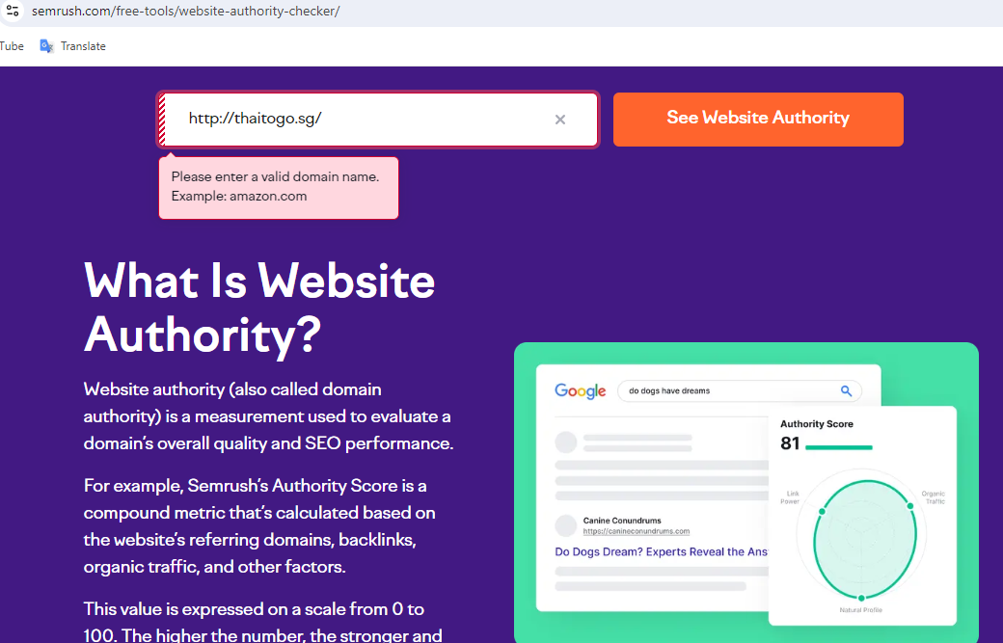
https://www.semrush.com/
http://thaitogo.sg/

Slide 33
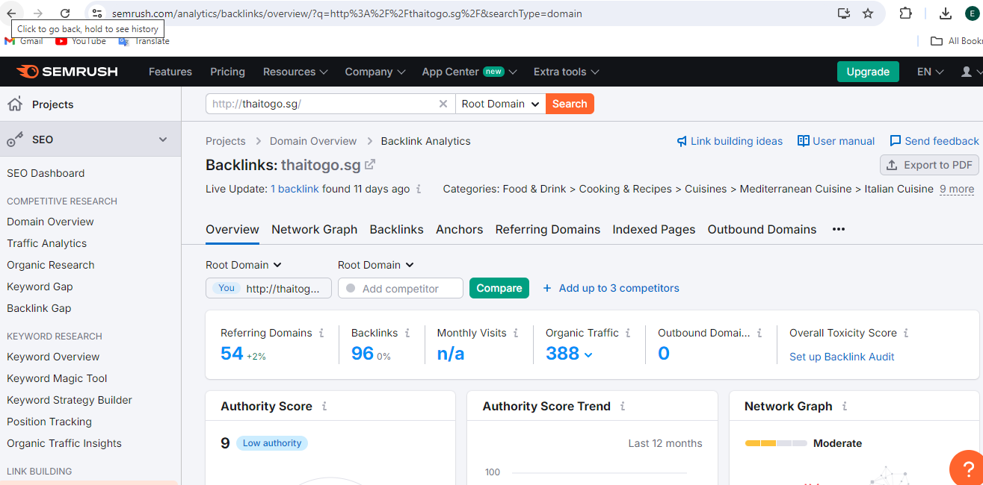
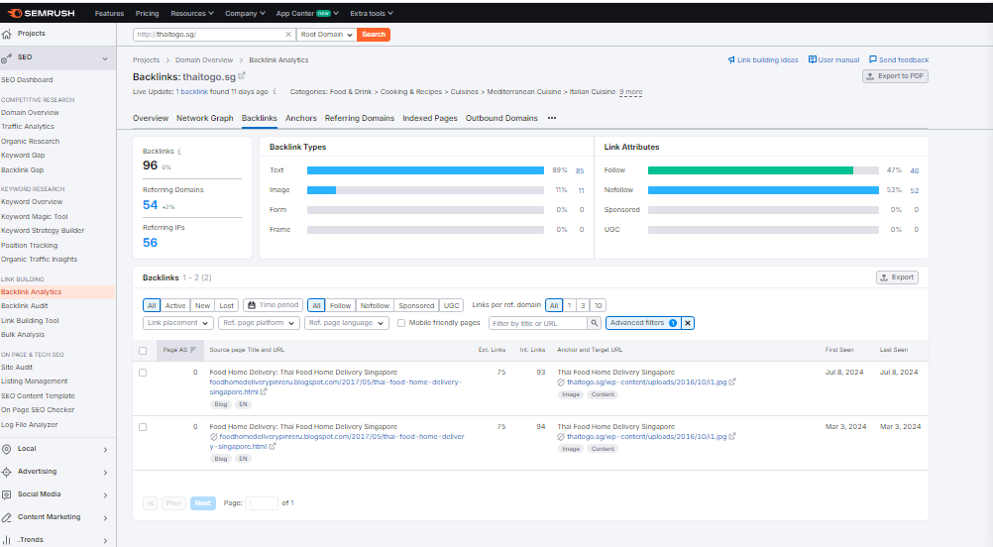
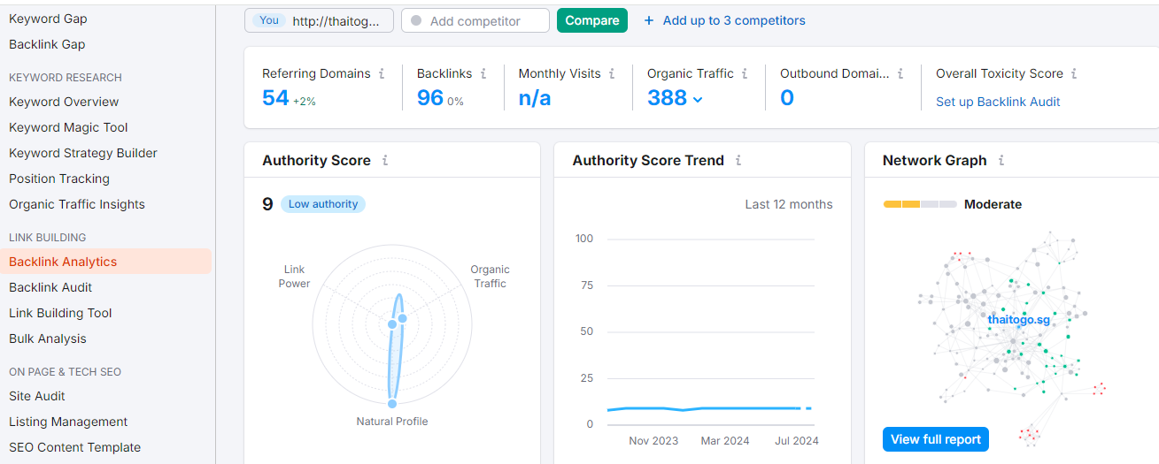
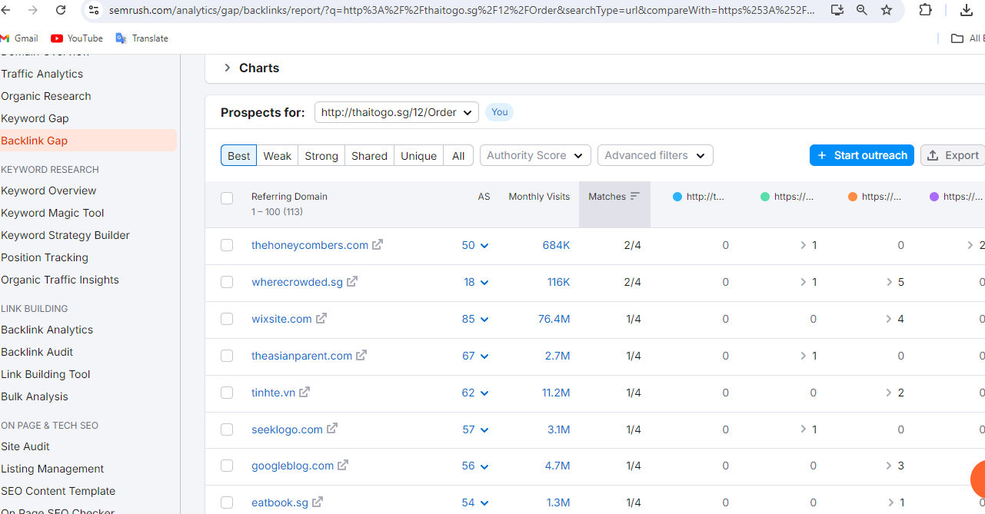
http://thaitogo.sg/12/Order
https://www.semrush.com/
33

Slide 34
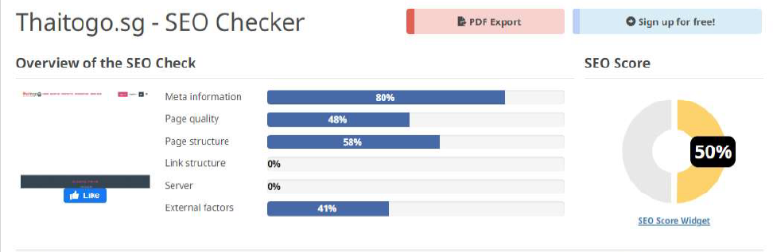


https://freetools.seobility.net/en/seocheck/thaitogo.sg

Slide 35



thaiexpress.com.sg | Website SEO Review | Seobility.net

Slide 36



https://freetools.seobility.net/en/seocheck/sanookitchen.com.sg

Slide 37

Competitive Analysis
Social Media

Slide 38
Category | Critical Area to Look at | Why It Is Important
1. Audience Engagement | - Likes, shares, comments, and reactions - Follower growth rate | Understanding engagement helps gauge content resonance and audience growth strategies. It indicates what type of content generates interaction and can inform your content strategy.
2. Content Strategy | - Types of content posted (videos, images, live streams, etc.) - Frequency and timing of posts | Identifying the content mix and posting schedule can reveal what keeps the audience engaged and when they are most active, helping to optimize your content strategy.
3. Advertising | - Ad formats used (carousel, video, etc.) - Targeting strategies - Estimated ad spend | Analyzing competitors' ads provides insight into creative strategies and audience targeting, offering clues to effective advertising practices and budget allocation.
4. Engagement Tactics | - Contests, giveaways, polls, etc. - Use of Facebook Stories and Groups | Special engagement tactics can significantly increase interaction and loyalty. Understanding these can help in crafting compelling campaigns.
5. User Interaction | - Response time to comments and messages - Type of responses (personalized vs. automated) | Prompt and effective communication builds trust and community. Observing how competitors manage interactions can improve your customer service approach.
6. Performance Metrics | - Engagement rate- Click-through rate (CTR) for ads - Conversion rate | Metrics offer a direct comparison of effectiveness. Analyzing these can help in setting realistic performance goals and refining your marketing strategies.
7. Branding and Positioning | - Tone of voice - Visual branding in content and ads | The way competitors position themselves and communicate can provide insights into market expectations and opportunities for differentiation.

Slide 39

Social Media Marketing Analysis - the critical areas to note:
1. Social Media Presence
Integration and Activity
Active social media presence and
integration can drive more traffic,
enhance brand visibility and improve
social engagement.
Use of Marketing Tools
Use of Marketing Analytics
Analytics provide insights into user
behavior, helping to tailor strategies for
better results.
Email Marketing Integration
Effective email marketing can drive
engagement, retention, and
conversions and actions to buy.
39

Slide 40
Social Media Marketing Analysis – the critical areas to note:
2. Social Media Performance Analysis
(Thaitogo Restaurant Vs Competitors)
Platforms Used
Facebook / Instagram
Key Metrics to Check:
Engagement Rates *
(likes, comments, shares)
No. of Followers *
(indicating relevance & growth)
Content *
Posts, Stories, Videos
Posting Frequency
Customer Engagement, Reviews &
Testimonials
Positive reviews and testimonials build trust and credibility, influencing buying and ordering patterns.
Feedback 360 can enhance the brand's reputation and encourage new customers to choose Thaitogo restaurant.
40

Slide 41


FACEBOOK
Instagram
41

Slide 42

https://www.facebook.com/ThaiExpressSG/
Audience
Engagement
42

Slide 43




Content Strategy on Facebook Posts
# Hastag
# Hastag
NO ADVT
# Hastag
X

Slide 44


https://www.instagram.com/thaiexpresssg/related_profiles/?hl=en

Slide 45


https://www.facebook.com/pages/Sanook-Kitchen/407681520052584/
No Cover Photo
Audience
Engagement
User Interaction
45

Slide 46




Content Strategy on Facebook
Strong
User Interaction
@ Various Sanook Kitchen
outlets
Customer Posts
NO ADVT
X

Slide 47

0
Content Strategy

Slide 48




https://www.instagram.com/singaporefoodstory/p/Cs-AJmoSNgz/?img_index=1

Slide 49


https://order.nakhonkitchen.com/?StoreID=99a9f721-e472-4e69-afb4-2a7f156d48aa&Service=Delivery&lang=EN
No Cover Photo
User Interaction
Audience
Engagement
49

Slide 50



Slide 51


DEEP DIVE – FACEBOOK - https://www.facebook.com/Thaitogo.sg/
Audience
Engagement
http://thaitogo.sg/12/Order
X
NO ADVT

Slide 52

https://www.facebook.com/Thaitogo.sg/
Audience
Engagement
3
52

Slide 53






http://thaitogo.sg/12/AboutUs
53

Slide 54

Competitive Analysis
Social Media Ads
https://www.facebook.com/ads/library/

Slide 55









4 STARS
4.1 STARS
NO ADVT
4.5 STARS
Website: http? Not secured
NO ADVT
NO ADVT
https://www.facebook.com/ads/library/

Slide 56
Category | Critical Area to look out | Why It Is Important
1. Audience Targeting | Demographics, Interests | Understanding the audience your competitors target can reveal gaps in the market or opportunities to refine your own targeting strategies.
2. Ad Content | Messaging and Value Proposition | Analyzing the core messages and value propositions helps to differentiate your offerings and identify what resonates with the audience.
 | Visual Elements | The use of images, videos, and design in ads can influence engagement rates; understanding what works can inform your creative strategy.
3. Ad Types | Formats Used | Identifying which ad formats (e.g., carousel, video, stories) competitors use most effectively can guide your ad format choices.
4. Engagement | Likes, Shares, Comments | High engagement rates indicate content resonance; analysing these metrics helps identify effective content types and topics.
5. Call to Action (CTA) | Clarity, Urgency | The effectiveness of CTAs can significantly impact conversion rates; studying competitors' CTAs can inspire more compelling ones.
6. Campaign Structure | Campaign Goals, Ad Sets | Understanding the structure and goals of competitors' campaigns can provide insights into effective campaign management strategies.
7. Budget and Bidding | Estimated Ad Spend | Although exact budgets may be unknown, indicators of Ad Spend and bidding strategies can help in your budget allocation decisions.
8. Performance Metrics | Click-Through Rate (CTR), Conversion Rate | Benchmarking these metrics can help gauge the effectiveness of your ads relative to the competition and industry standards.
9. Trends and Innovation | Use of New Features or Platforms | Observing how competitors adopt new social media features or platforms can reveal emerging trends and opportunities for innovation.

Slide 57
Customer Journey
Customer Life Stage | Digital Marketing Channels | Contents/Ideas
Awareness | SMM / SMM Ads SEO SEM | BOOST Posts or Run Ads showcasing the unique flavor and new localised Thai-Malay fusion recipes
Consideration | Enhanced Website Current Email Lists from Website/Call in | Video & Food Posts, Customer Reviews Email featuring Promotion & Online Order links
Decision | Online Ordering Phone In or WhatsApp Call | Call to Action (CTA) - Order Now - Book Now - Special Offers, Freebies Now

Slide 58
Marketing Funnel
Awareness
01
- Utilise SEO & SMM on Facebook, Instagram & TikTok to run targeted ads on Thaitogo restaurant’s signature dishes with clear CTA
Interest
02
- Website to promote limited-time offers discounts for first-time customers to entice them to try the restaurant or order online.
Desire
03
Join local events at Geylang Serai and Festivals
to increase brand visibility and promote
- Word of Mouth Recommendations to attract new clients and reward repeat customers with freebies,.
04
Action
- Seamless Online Ordering System to ensure easy online ordering, user-friendly and mobile-optimized.

Slide 59
Smart Goals
Channel | Metric | KPI | Duration | Notes
1. Social Media - Facebook - Instagram | 500 Likes 100 shares | +30% | 6 to 9 months | Call to Action (CTA)
2. Landing Page / Website | Increase Session/ Duration | +30% | 6 months | Order Now (CTA)

Slide 60
Marketing Prioritization
High Impact | Easy to execute and high impact, must be done, Top priority | Costly to execute but potentially high impact, Medium priority
 | Enhanced SEO Content Marketing Social Media Campaigns | Influencer Partnerships Comprehensive Digital Ad Campaigns Data Analytics Implementation
Low Impact | Easy to execute but not much impact on marketing results, low priority | Costly to execute with low returns, do not execute
 | Routine Website and Social Media Updates | High-Cost Events or Sponsorships
 | Low Cost to Execute | High Cost to Execute

Slide 61

Marketing
Execution

Slide 62

Search Engine Marketing
https://adstransparency.google.com/?region=SG

Slide 63
Category | Critical Area to Look Out | Why It Is Important
1. Keywords | Targeted Keywords | Understanding the keywords your competitors target can reveal gaps in your strategy or highly contested areas worth focusing on.
 | Keyword Match Types | Analyzing the match types used (broad, phrase, exact) can offer insights into competitors' targeting precision and strategy.
2. Ad Copy | Headlines and Descriptions | Effective ad copy is crucial for high CTR. Studying competitors' copy can inspire ways to differentiate and improve your own ads.
 | Unique Selling Propositions (USPs) | Identifying competitors’ USPs in ads can help you refine your value proposition to stand out in the search results.
3. Landing Pages | Page Design and Content | The design and content of landing pages directly impact conversion rates. Analyzing these can provide ideas for optimization.
 | Call to Action (CTA) | Effective CTAs on landing pages are key for conversions. Studying competitors’ CTAs can inspire more compelling ones for your pages.
4. Ad Extensions | Types of Extensions Used | Ad extensions enhance ad visibility and effectiveness. Understanding which extensions competitors use can guide your extension strategy.
5. Bidding Strategies | Ad Position and Visibility | Although exact bid amounts are unknown, ad positions can indicate competitors’ bidding strategies and priority keywords.
6. Performance Metrics | Click-Through Rate (CTR), Conversion Rate | Benchmarking these metrics can help gauge the effectiveness of your ads and landing pages relative to the competition.
7. Geographic Targeting | Targeted Locations | Analyzing geographic targeting can reveal market priorities and regional strategies, offering insights into potential niche markets.
8. Scheduling | Ad Scheduling | Competitors’ ad schedules can indicate when they aim to capture the most traffic, informing your own ad timing decisions.
9. Budget Allocation | Estimated Spend | While exact budgets may be confidential, indications of spend can inform your budget decisions and reveal competitor priorities.
10. Trends and Innovation | Use of New Ad Features or Technologies | Keeping an eye on competitors’ adoption of new features or technologies can highlight trends and opportunities for innovation.

Slide 64

SEM - Google Search Ads (Target Audience)
Read more about Audience Segments https://support.google.com/google-ads/answer/2497941
Audience segments targeting setting – my screenshot.

Slide 65

SEM - Google Search Ads (Target Audience)
Audience segments –select targeting setting - my creenshot.

Slide 66


SEO - Google Search Ads
http://thaitogo.sg/12/Order
here is my screenshot

Slide 67





http://thaitogo.sg/
here is my extra screenshot
https://www.bing.com/search?q=Thaitogo%20Restaurant%20offerings&qs=ds&form=ATCVAJ

Slide 68



SEM - Google Search Ads (Ad mock-ups)
here is my screenshot
Google Search ads are text ads shown in Google Search Results Pages

Slide 69




https://nordicclick.com/resources/google-ads-preview-tool/
Using Keywords (Ad mock-ups)
here is my screenshot

Slide 70
https://nordicclick.com/resources/google-ads-preview-tool/
Using Keywords (Ad mock-ups)
here is my screenshot
9

Slide 71
https://nordicclick.com/resources/google-ads-preview-tool/
Using Keywords (Ad mock-ups)
here is my screenshot

Slide 72

Search Engine Optimization
(Google Display Network Ads)
https://www.canva.com/web-ads/templates/mobile-banner-ads/
My Screenshot A in edit mode

Slide 73

Search Engine Marketing
(Google Display Network Ads)
https://www.canva.com/web-ads/templates/mobile-banner-ads/
My Screenshot B in edit mode

Slide 74

Search Engine Marketing (Google Display Network Ads)
https://www.canva.com/web-ads/templates/halfpage-ads/
My Screenshot A - in edit mode

Slide 75

Search Engine Marketing (Google Display Network Ads)
https://www.canva.com/web-ads/templates/halfpage-ads/
My Screenshot B – in edit mode

Slide 76

Search Engine Marketing (Google Display Network Ads)
https://www.canva.com/web-ads/templates/billboard-ads/
My Screenshot – in edit mode

Slide 77

SOCIAL MEDIA
Marketing

Slide 78

Social Media Organic Post
https://www.facebOok.com/ads/library/
https://www.in%stagram.com/

Slide 79


Social Media Marketing
(Facebook Organic Post)
🌶️ Craving Authentic Thai Flavors? 🌶️
Bring the taste of Thailand right to your doorstep!
Our mouth-watering dishes are just a click away.
Whether you're planning a cozy family dinner or a quick lunch, Thaitogo has got you covered with fresh, flavorful dishes delivered right to you!
ORDER NOW! CALL NOW @ +65 6396 9696
CLICK the LINK Below:
#Thaitogo Restaurant
http://thaitogo.sg/12/Order

Slide 80


https://mediamodifier.com/mockup/facebook-regular-post/4223
https://mediamodifier.com/mockup/facebook-page-in-iphone-mockup-generator/36316

Slide 81

My Screenshot – in edit mode
Social Media Marketing (Instagram Post)
https://www.canva.com/

Slide 82

https://mediamodifier.com/mockup/instagram-carousel-ad-mockup-generator/11081

Slide 83


https://mediamodifier.com/social/
instagram

Slide 84
Social Media Ads
https://www.facebook.com/business/help/717368264947302
About reaching new audiences | Meta Business Help Centre (facebook.com)

Slide 85
DEEP DIVE – FACEBOOK - https://www.facebook.com/Thaitogo.sg/
NO ADVT
http://thaitogo.sg/12/Order
X

Slide 86
To BOOST Post
(Facebook Organic Post)
🌶️ Craving Authentic Thai Flavors? 🌶️
Bring the taste of Thailand right to your doorstep!
Our mouth-watering dishes are just a click away.
Whether you're planning a cozy family dinner or a quick lunch, Thaitogo has got you covered with fresh, flavorful dishes delivered right to you!
To Order Now, please Call +65 6396 9696 or
CLICK the LINK Below:
#ThaitogoRestaurant #OnlineOrders #SingaporeEat
http://thaitogo.sg/12/Order

Slide 87

🚚 Order Now and Enjoy:
✅ Free delivery for orders over $50
✅ 10% off your first online order with code Thaitogo10
✅ Family-friendly portions
Don't miss out!
Your next delicious Thai meal is just a tap away. 🍛🥢
Order NOW! Call +65 6396 9696
🔗 CLICK the LINK Below:
To BOOST
Post
Social Media Marketing (Facebook Organic Post)
#ThaitogoRestaurant #OnlineOrders #SingaporeEat
http://thaitogo.sg/12/Order
87

Slide 88





TO BOOST POST on Facebook
Customer Reviews
5 Stars = 67%
out of 500 reviews

Slide 89




TO BOOST POST on Facebook
Customer Reviews
4.6 Stars
from 15 reviews
/

Slide 90

Marketing Campaign Tool
for Conversion, Increase SEO,
and Brand Building
Landing Page Proposal

Slide 91

Landing Page 1
Taste
Authentic
Thai Cuisine
Screenshots x 7 pages in edit mode for DESKTOP preview

Slide 92

Landing Page 2
Special Menu
for the month
(all links are active)

Slide 93

Landing Page 3
Satisfy Your Taste Buds

Slide 94

Landing Page 4
Customer Reviews
from
Delivery Partner
Food Panda

Slide 95

Landing Page 5
Customer Reviews
from
Delivery Partner Deliveroo

Slide 96

Landing Page 6
Don’t Wait -
Experience ….

Slide 97

Landing Page 7
Welcome to
Our Store

Slide 98



Landing Page
Screenshot in Mobile Preview

Slide 99


Conclusion
This digital marketing plan targets Malay couples with young children to drive an increase in online orders.
2. Reap Benefits
Ensure sustained growth in online orders.
Increase in market share
Establish Brand loyalty within the Malay community.
1. Focus on Cost-effective strategies
Optimize for Local SEO
Run Targeted Ads on Social Media
Eye-catching Family Meals & Yummy Food Menu Content to maximize impact
Offer Discounts for First-Time orders.

Slide 100

THANK YOU! Q & A

Slide 101
APPENDIX

Slide 102
Link References
1. Check Meta Ad Library of your company & competitors’ to determine if
they are running ads
https://www.facebook.com/ads/library/
Alternatively, look at the page’s page transparency
2. Simulate the custom audience you are targeting in
facebook and Instagram
Learn more about saved audiences here https://www.facebook.com/business/help/717368264947302
3. Simulate ads here
https://nordicclick.com/resources/google-ads-preview-tool/ to
mockup search text ads, at least 3 ads
4. Read more about Audience Segments here
https://support.google.com/google-ads/answer/2497941
1. Use the digital marketing tools to assess your company & competitors’ website performance such as;
https://www.semrush.com/
https://neilpatel.com/ubersuggest/
https://www.similarweb.com/
https://images.google.com/

Slide 103
Link References
https://www.tiktok.com/@kopiboydecaf/video/7135053162939026690
https://www.canva.com/web-ads/templates/mobile-banner-ads/
https://www.canva.com/web-ads/templates/halfpage-ads/
https://www.canva.com/web-ads/templates/billboard-ads/
Simulate creating one social media post using
Use https://www.canva.com/ to create post images
Use https://mediamodifier.com/social/instagram to simulate how the post looks, there are other social media channel mockups on this page

Slide 104


Expected Deliverables (To pass this module)
✓
Scoping the purpose & objectives of a digital marketing campaign in accordance with a company’s requirements
A SWOT analysis on competitor landing pages and creating a conversion focused landing page that stands out from the competition
One highly engaging content for web (blogpost, brochure, EDM, video, etc) and one social media post (image or video with caption along with copywriting)
One Ad copy for search, display, and/or social media and an -SEO optimised blog article or lead magnet for content marketing
A completed setup of Google Ads Search or Display campaign to market a company’s products & services
A completed setup of social media campaign mockup to drive awareness and conversions for a company’s products & services
An evaluation of digital marketing campaigns (across the user journey, e.g. website, advertising performance, content analytics) using various conversion optimisation models to meet company’s requirements & objectives
✓
✓
✓
✓
✓
✓

